Slide 1

Adaptive LED Strip
Aidan Cioppa , Michael Percival

Slide 2
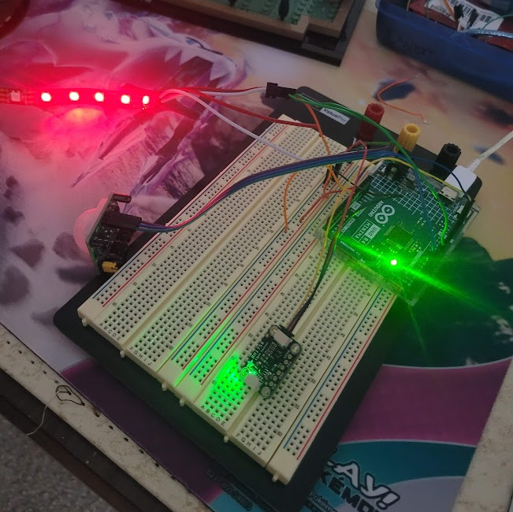
What is an Adaptive LED Strip
Brightness of LED adapts to the light level of the room it is in
On/off toggleable with motion sensors
Color adjustable with minor code tweaks

Slide 3
Features
Adjustable motion detection range/timeout
Adjustable color
Easily invertible logic, i.e. light room = bright instead of light room = dark
Simple setup and use

Slide 4
Difficulties – Insufficient Memory
The uno has a small amount of memory and each individual LED in the strip requires about 4 bytes of memory.
Due to the necessary size of tasks, this caused all the memory to be used when addressing only 3 LEDs in the strip.
Due to this, a board with more memory had to be used in order to allow for ~200 LEDs in the strip to be used with space to build on color toggling in the future

Slide 5

Difficulties – Motion Sensor Lockout
The motion sensor has a short lockout period of around 3 seconds where it cannot read high after a high read.
This causes the motion input to not be quickly (less than a second) toggled back-to-back.
This is acceptable as it is unlikely you would want to turn it on and off that frequently.
A hard 3s lockout was implemented in code to account for this, and has the side effect of preventing accidental toggles as the sensor is very sensitive

Slide 6

Future improvements
Color toggling has begun to be implemented in the codebase.
We would like to expand the available color options to toggle through.
Currently the strip is defaulted to red.
Within the color toggle prototype, the strip will rotate between red, blue, and purple.
There is no option to turn strip off, however this could be added by having one of the “colors” in the rotation be black (off).

Slide 7

Future improvements
After that is implemented, we would look into a sensor that would allow for real time color selection.
This way you do not need to re-code a new color option.
This would likely require a sensor with more precise I/O capabilities.
Though, the convenience of adjusting color without having to hard code it in would be fun to investigate.

Slide 8
Future improvements
Additional features could include:
A color change along with brightness change dependent on the room brightness
Having an on/off toggle and a color toggle (2 PIR sensors)

